Slide 1
Green Energy from Recycled Fat, Oil, and Grease
SD II Presentation
By: Angel Olvera, Miguel Urias, Viridiana Ortega, & Abel Becerra
Prepared For: Dr. Kamal Sarkar & Dr. Stephen Crown

Slide 2
Outline
Senior Design I Recap
Background
Goals & Objectives
Competitive Products
Needs & Wants
QFD
Constraints
Overview /Proposal
Methodology
Conceptual Design
Prototype Manufacturing
Grease Trap Frame
Nano-Glass Container
Baffle
“Smart” Alarm System
Comparison to CAD
Design Validation
Prototype Flow Test
Heat Output
Test Protocols
Data Collected
Discussion:
Best Practices
Lessons Learned
Business Opportunities
Summary
References

Slide 3
Senior Design 1 Recap

Slide 4
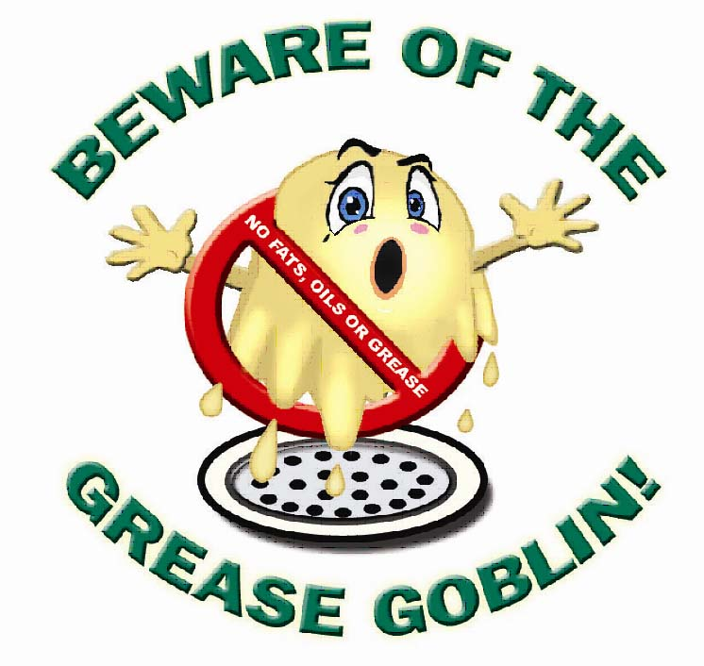
Background:
There are 40,000 sewer overflows/year in the U.S.A
47% are F.O.G related
Results in $40 million in expenses
Leads to water quality issues & property damage
F.O.G must be stored & disposed in safely
Grease trap maintenance is expensive
Typically serviced once per month
Most times, grease trap isn't full to capacity
*Reference #1

Slide 5
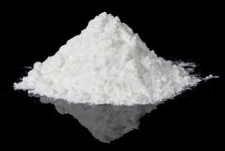
Glass Nanoparticles:
12 million tons of glass are produced per year.
Made from recycled pulverized glass.
Lipophilic
Hydrophobic
Reusable
Pulverized Glass
Ball Mill
Nano glass
*Reference #2

Slide 6
Goals & Objectives:
Goals :
Objectives:
Build “smart” grease trap
Use glass Nano-particles to absorb oil
Reduce customer grease trap maintenance costs
Create alternative source of Green Energy
Solve municipal solid waste problem (glass)
Create grease Trap prototype
Test oil absorption capacity of glass Nano-particles
Burn recovered oil for energy output
Check whether fumes are safe for the environment
Create sensor to warn when trap is ≈ 85% full

Slide 7
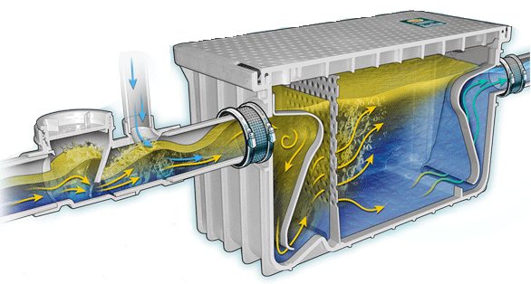
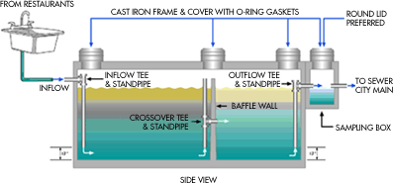
Types of Grease Traps:
*Reference #3

Slide 8
Needs & Wants:
Needs:
Wants:
Great F.O.G Separation
Great F.O.G Retention
Adequate Capacity (Size)
Environmentally Friendly
Minimal Maintenance “Smart”
Good Odor Control
Reusable nano-glass container
Clean Burning Process
Explore Potential to Retrofit

Slide 9
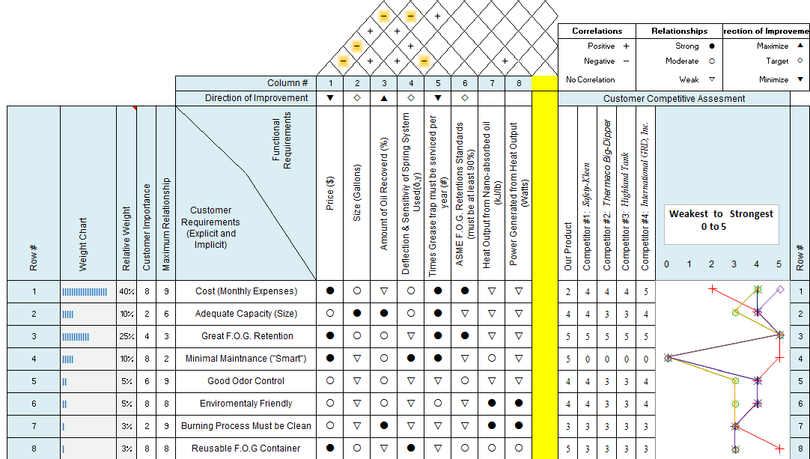
Quality Function Deployment (QFD)

Slide 10
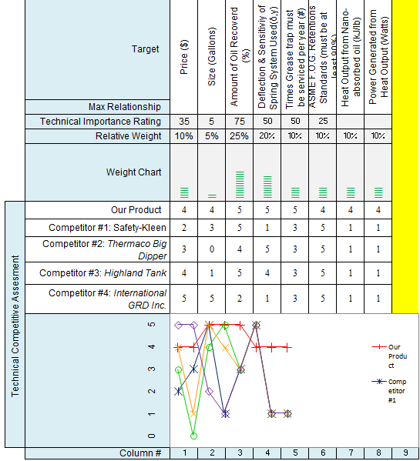
QFD Cont.
Notes:
* Used References 4-8

Slide 11
Overview & Proposal

Slide 12
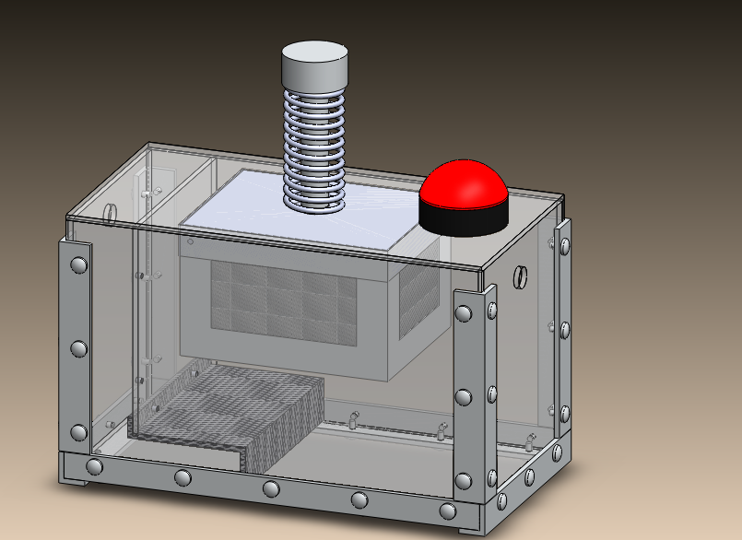

Slide 13
Prototype Manufacturing

Slide 14
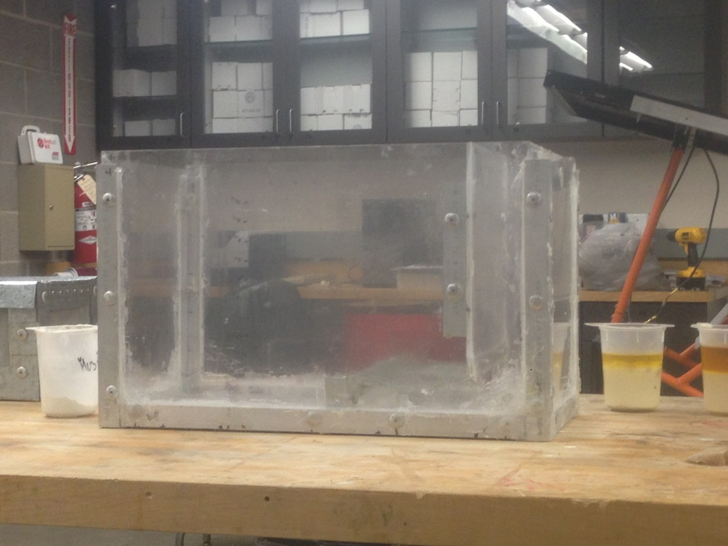
Grease Trap Frame:
Dimensions of Grease Trap are:20’’x12’’x10’’
Volume : 2400 in³
Weight: 12.5 Ibs.
Capacity: 10.4 Gallons
80% Capacity for Design Purposes: 8.7 Gallons

Slide 15
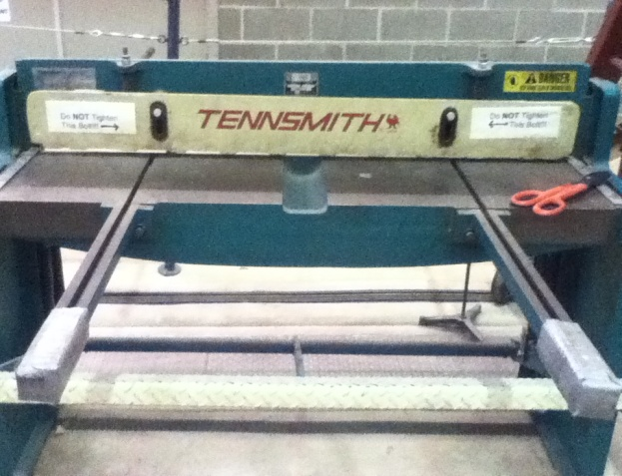
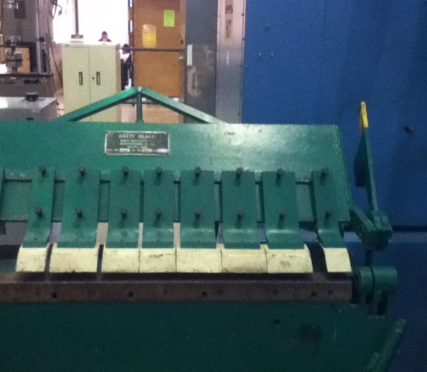
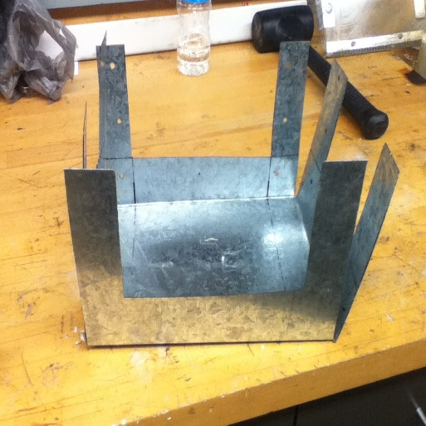
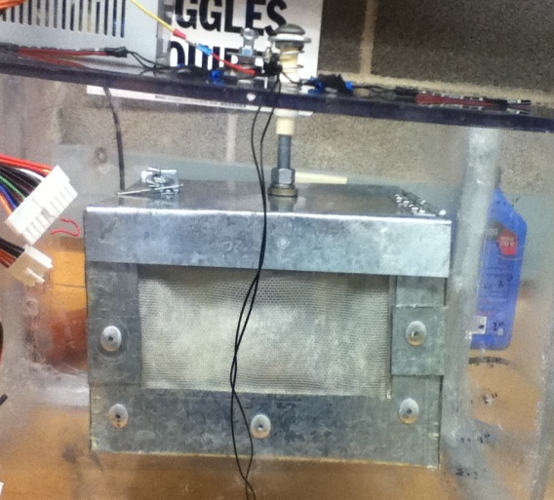
Nano-Glass Container:
Cutting & Bending of Aluminum Sheet of Metal.
Mesh was integrated separately.
Components riveted in place.
Hinges were added for easy removal of NanoGlass
Cutting Tool
Bending Tool
Frame
Finished Product

Slide 16
Baffle:
A sheet of Polycarbonate was Cut w/ dimensions to fit the Grease Trap.
A mesh was riveted on to prevent solid food particles from flowing downstream.
PC Cutting Tool

Slide 17
“Smart” Alarm System:
A bolt, fitted w/ a compression spring, was attached to the NG container.
Once the bolt compresses 1”, the LED strips are triggered ON.

Slide 18
CAD & Prototype Comparison:
Spring
LED Strip
LED Strip
NG Container

Slide 19
Design Validation

Slide 20
Prototype Flow Test:

Slide 21
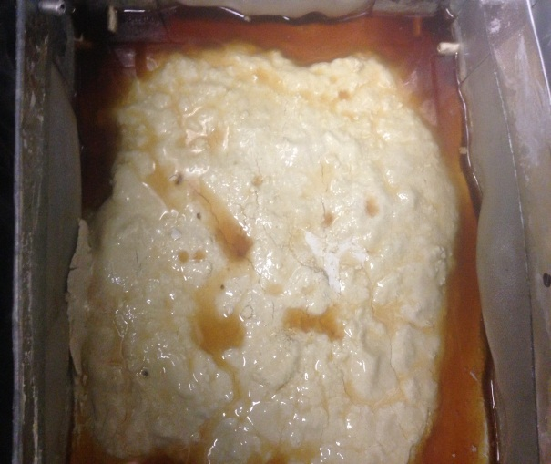
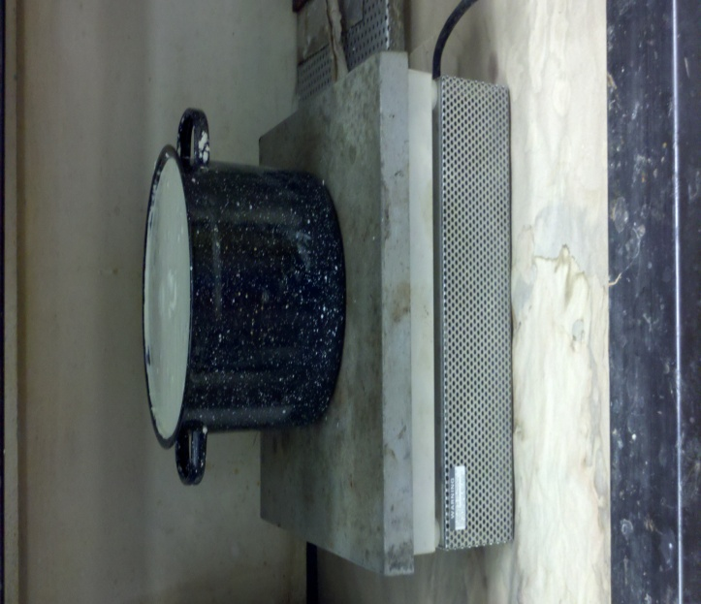
Oil Coated Nano-Glass:
In one test run, of this slur was recovered.
Composition:
11% H2O
17% Cooking Oil
72 % Nano Glass
This material could now be used for a variety of purposes.
(e.g. BBQ Briquettes)
NG / Oil/ Water Slur

Slide 22
Data Collected:
A small sample of the slur was burned to obtain the respective composition .

Slide 23
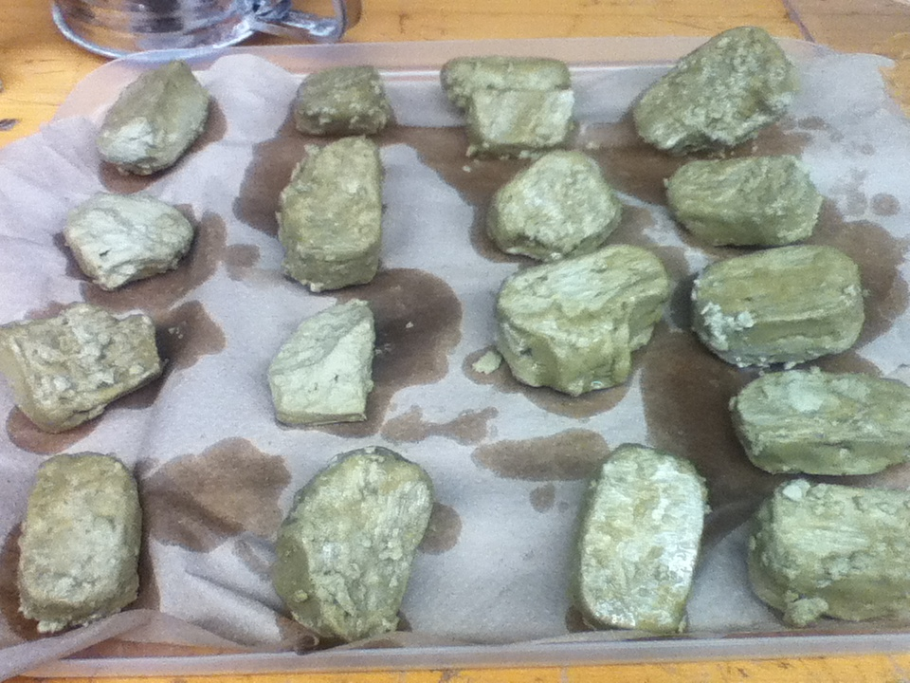
Test Protocols:
Manufacturing NG Clay Briquettes:
Burning Briquettes:

Slide 24
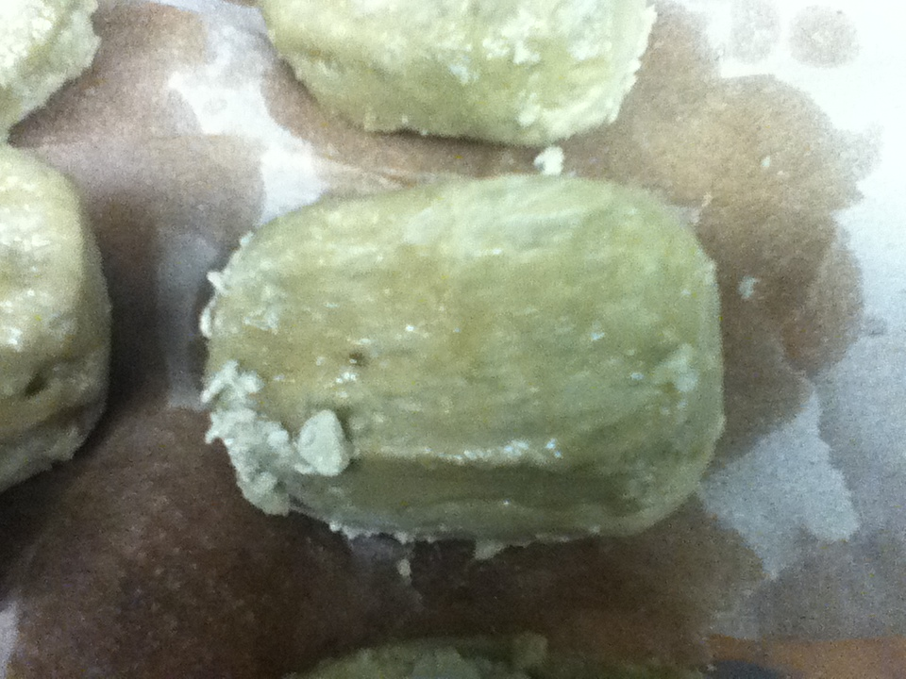
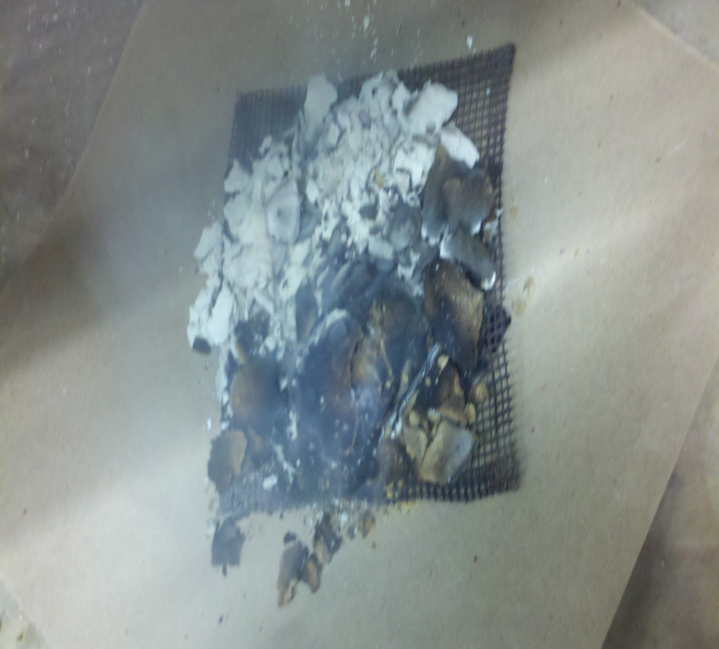
Test Results:
Before (Avg: 86 g)
After: (62 g of NG)

Slide 25
Heat Content:
With the use of calorimeter, the heat outputs by combustion for liquid oil and NG-clay were found to be:
Restaurant Oil: 28.05 kJ/mL 33.7kJ/g
=1528kJ/lb
Nano-Glass Clay: 5.69 kJ/g 258kJ/lb

Slide 26
Briquette Burning Time:

Slide 27
Gantt Chart

Slide 28
Discussion

Slide 29
Best Practices:
Communication as a major practice
Good presentation skills
Think of methods to save time and money
Reduce waste of materials
Learn to be an entrepreneur

Slide 30
Lessons Learned:
Try and investigate different processes to manufacture our prototype
Perform the work in advance
Time management skills

Slide 31
Market Summary
Grease trap services have always been an important part of any food establishments’ (restaurants, schools, hospitals, etc.) operational expenses.
Today this industry generates roughly $390 M in revenue, and consists of over 450 companies which employ more than 4,000 people.
However, none of the companies in this industry generate more than 5.0% of the industry's revenue.
Reference 3
Notes:
Summarize your market in the past, present, and future.
Review those changes in market share, leadership, players, market shifts, costs, pricing, or competition that provide the opportunity for your company’s success.

Slide 32
Business Opportunities (Future Work)
Retrofit FOG Chambers
Supply the “Smart Sensors”
Create BBQ briquettes from the extracted oil soaked nano particles

Slide 33
Summary
Smart Grease Trap will allow for safe and effective disposal.
Design will warn consumers when trap is nearly full to capacity.
Use Recycled F.O.G as Biofuels
Redefine Sustainability using Recycled Glass

Slide 34
References
http://www2.nccde.org/Sewers/FOG/
http://www.epa.gov/conserve/materials/glass
www.greaseremovalsystems.com
http://www.calfog.org
http://www.big-dipper.com
http://www.highlandtank.com
http://www.igrd.com
http://www.safety-kleen.com

Slide 35
Questions?

